Slide 1
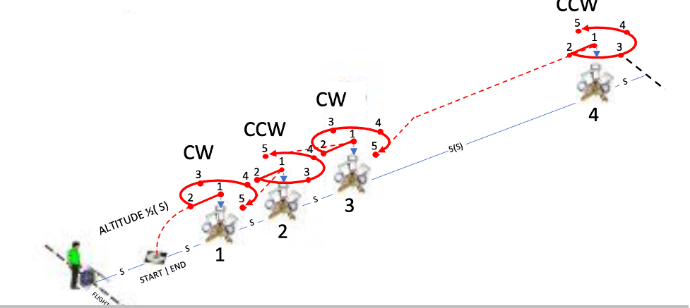


Inspect
NIST Open Test Range

Slide 2
Introduction
Perform detailed inspections around bucket stands at close proximity.
  Fly in closer proximity around objects to inspect detailed features on top and all four sides of the bucket stands.
  Maintain altitude 1/2(S) starting on top of each bucket stand with alternating leftward and rightward rotations to inspect all four sides of each bucket stand.
  Complete all 4 stands with 20 alignments to score up to 100 points.

Slide 3
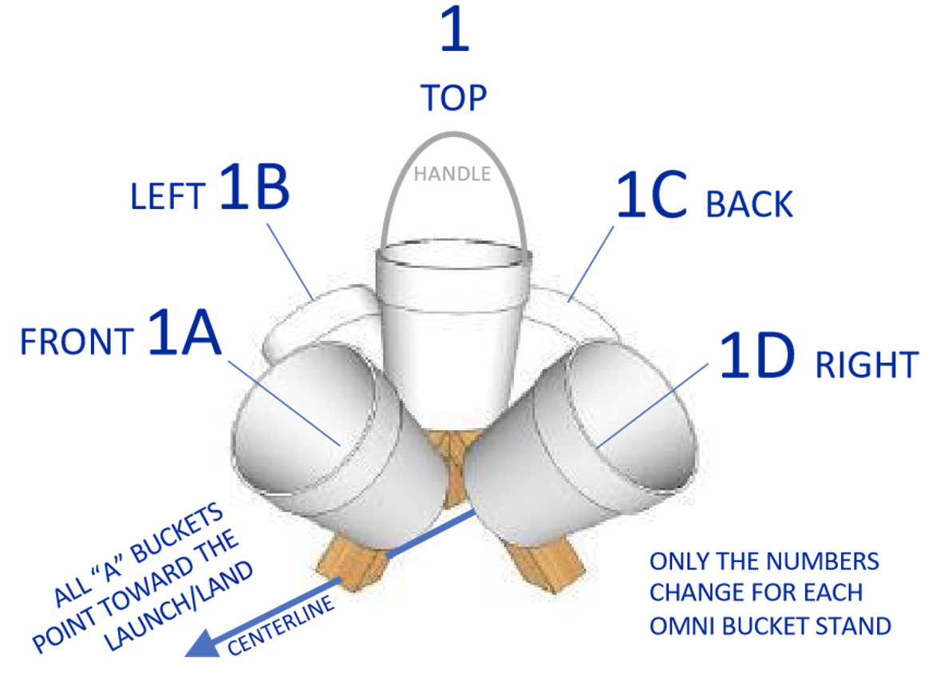
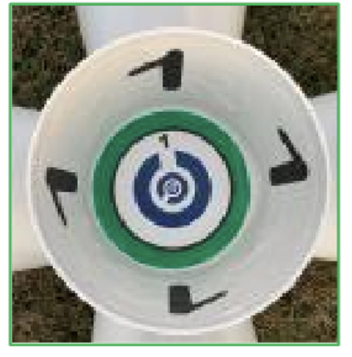
Setup

Slide 4
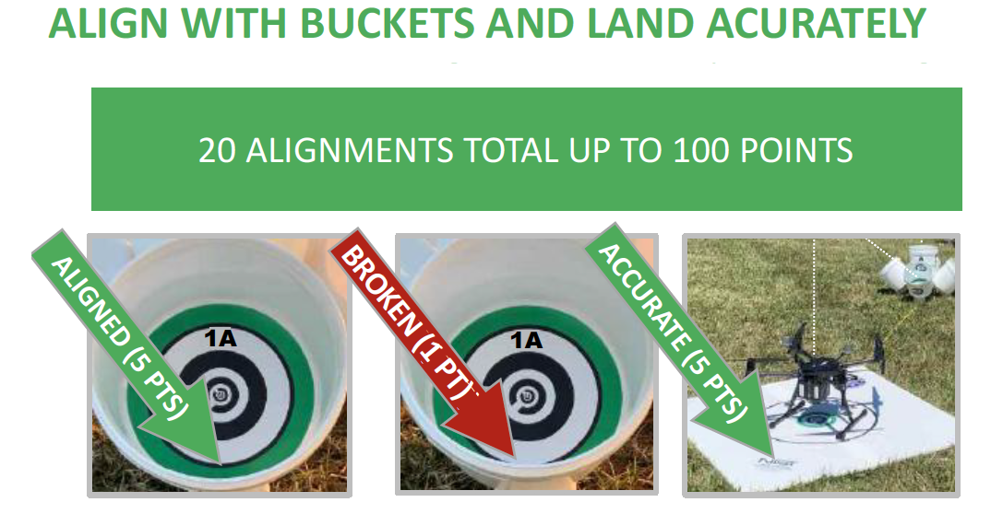
Scoring
Score captured images as:
  UNBROKEN RINGS (5 points)
  BROKEN RINGS (1 point)
  NO RINGS (0 points, strike through line)
Score accurate landings as:
  CENTERED (5 pts) with the aircraft center point inside the 60 cm (24 in) diameter circle.
  OFFSET (1 pts) with at least one propeller motor inside the circle.

Slide 5
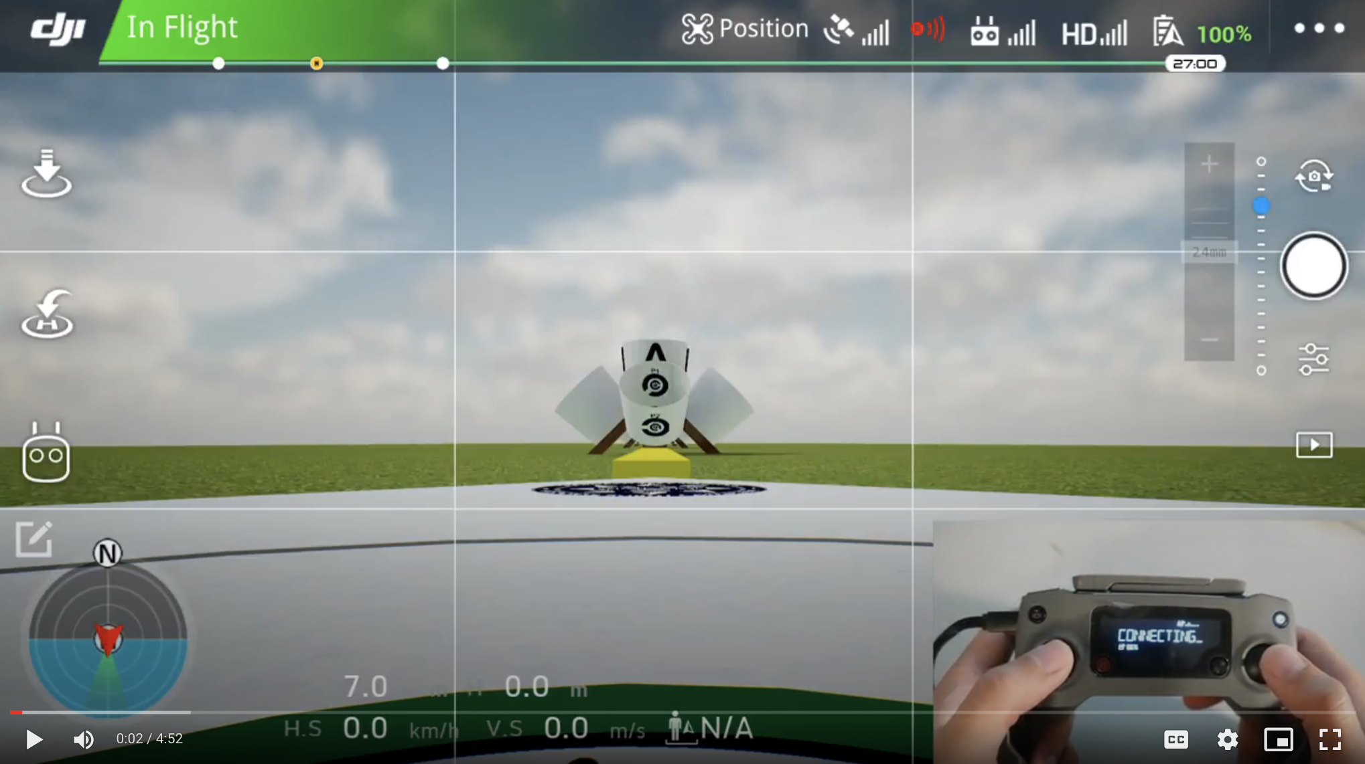
Inspect

Slide 6
Procedure
HOVER OVER STAND #1 AT ALTITUDE 1/2(S) TAKE BICTURE OF BUCKET 1
PITCH BACKWARD TAKE BICTURE OF BUCKET 1A
ORBIT LEFTWARD 90° TAKE BICTURE OF BUCKET 1B
ORBIT LEFTWARD 90° TAKE BICTURE OF BUCKET 1C
ORBIT LEFTWARD 90° TAKE BICTURE OF BUCKET 1D
HOVER OVER STAND #2 AT ALTITUDE 1/2(S) TAKE BICTURE OF BUCKET 2
PITCH BACKWARD TAKE BICTURE OF BUCKET 2A
ORBIT RIGHTWARD 90° TAKE BICTURE OF BUCKET 2D
ORBIT RIGHTWARD 90° TAKE BICTURE OF BUCKET 2C
ORBIT RIGHTWARD 90° TAKE BICTURE OF BUCKET 2B
HOVER OVER STAND #3 AT ALTITUDE 1/2(S) TAKE BICTURE OF BUCKET 3
PITCH BACKWARD TAKE BICTURE OF BUCKET 3A
ORBIT LEFTWARD 90° TAKE BICTURE OF BUCKET 3B
ORBIT LEFTWARD 90° TAKE BICTURE OF BUCKET 3C
ORBIT LEFTWARD 90° TAKE BICTURE OF BUCKET 3D
HOVER OVER STAND #4 AT ALTITUDE 1/2(S) TAKE BICTURE OF BUCKET 4
PITCH BACKWARD TAKE BICTURE OF BUCKET 4A
ORBIT RIGHTWARD 90° TAKE BICTURE OF BUCKET 4D
ORBIT RIGHTWARD 90° TAKE BICTURE OF BUCKET 4C
ORBIT RIGHTWARD 90° TAKE BICTURE OF BUCKET 4B

Slide 7
Orbit

