Slide 1
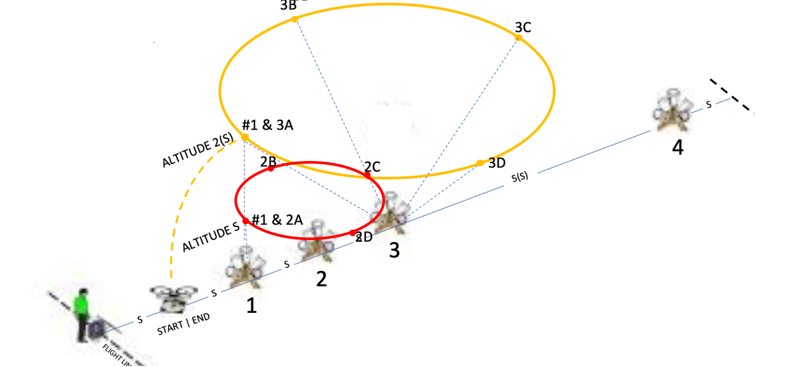


Orbit
NIST Open Test Range

Slide 2
Introduction
Fly orbits around bucket stands, capturing images of inscribed rings and identifying targets.
  Fly circular orbits around designated bucket stands while looking inward to identify features on all four sides. Fly altitude 2(S) leftward and rightward around stand #3, then altitude S leftward and rightward around stand #2.
  Each orbit has 5 bucket alignments starting with 1 downward radius check then 4 altitude checks around the orbit looking inward at the angled buckets.
  Complete 4 orbits with 20 alignments to score up to 100 points.

Slide 3
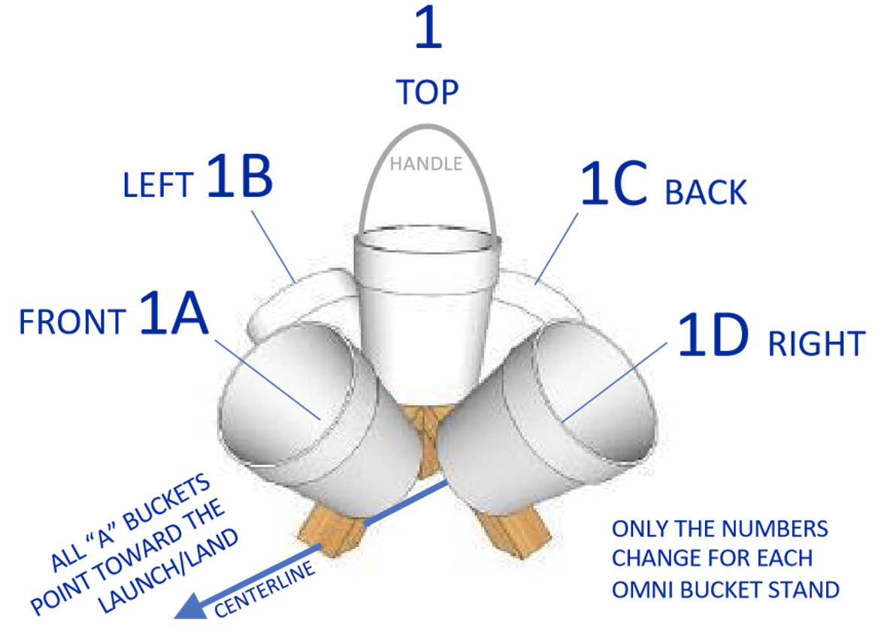
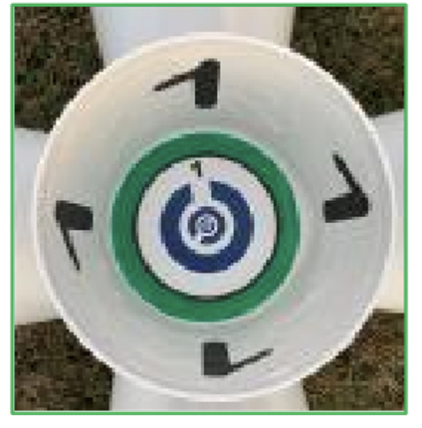
Setup

Slide 4
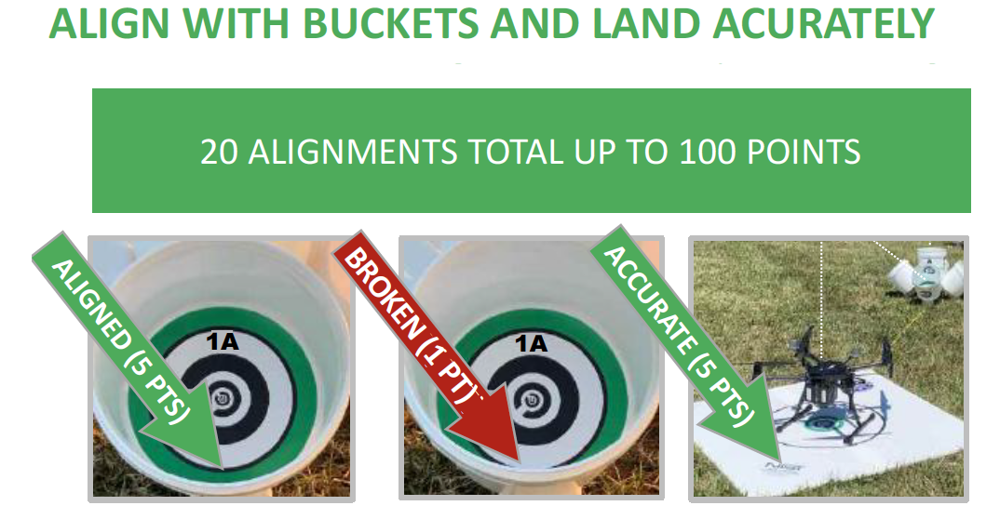
Scoring
Score captured images as:
  UNBROKEN RINGS (5 points)
  BROKEN RINGS (1 point)
  NO RINGS (0 points, strike through line)
Score accurate landings as:
  CENTERED (5 pts) with the aircraft center point inside the 60 cm (24 in) diameter circle.
  OFFSET (1 pts) with at least one propeller motor inside the circle.

Slide 5
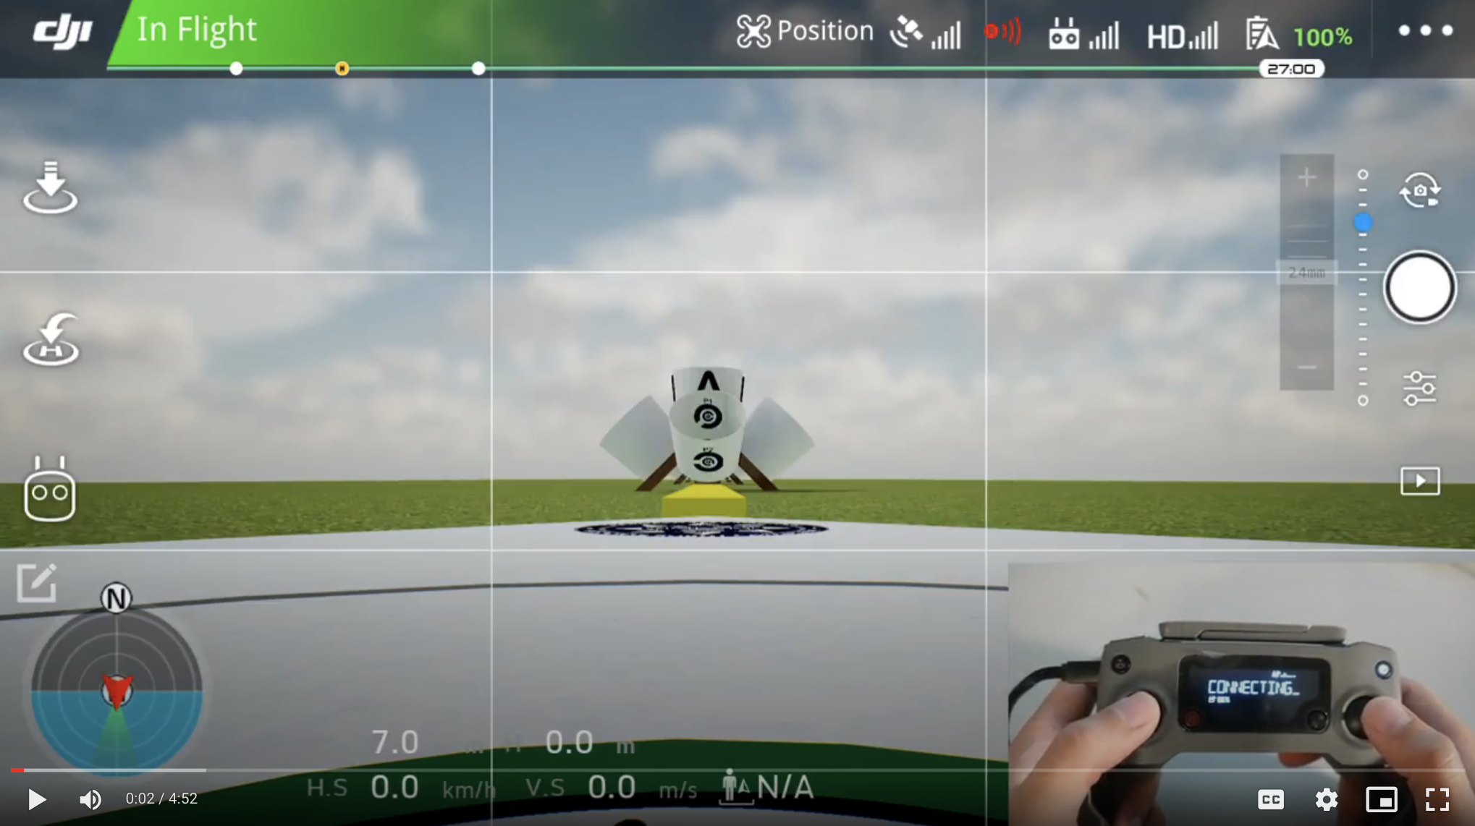
Orbit

Slide 6
Procedure
ALIGN OVER STAND #1 AT ALT 2(S) CHECK RADIUS TAKE PICTURE OF BUCKET 1
ALIGN WITH BUCKET 3A CHECK ALTITUDE TAKE PICTURE OF BUCKET 3A
ORBIT LEFTWARD 90° TAKE PICTURE OF BUCKET 3B
ORBIT LEFTWARD 90° TAKE PICTURE OF BUCKEY 3C
ORBIT LEFTWARD 90°TAKE PICTURE OF BUCKET 3D
ALIGN OVER STAND #1 AT ALT 2(S) CHECK RADIUS TAKE PICTURE OF BUCKET 1
ALIGN WITH BUCKET 3A CHECK ALTITUDE TAKE PICTURE OF BUCKET 3A
ORBIT RIGHTWARD 90° TAKE PICTURE OF BUCKET 3D
ORBIT RIGHTWARD 90° TAKE PICTURE OF BUCKET 3C
TAKE PICTURE OF BUCKET 3B
ORBIT RIGHTWARD 90° DESCENT TO (S) TAKE PICTURE OF BUCKET 1
ALIGN OVER STAND #1 AT ALT S CHECK RADIUS TAKE PICTURE OF BUCKET 2A
ALIGN WITH BUCKET 2A CHECK ALTITUDE TAKE PICTURE OF BUCKET 2B
ORBIT LEFTWARD 90° TAKE PICTURE OF BUCKET 2C
ORBIT LEFTWARD 90° TAKE PICTURE OF BUCKET 2D
ALIGN OVER STAND #1 AT ALT S CHECK RADIUS 90° TAKE PICTURE OF BUCKET 1
ALIGN WITH BUCKET 2A CHECK ALTITUDE TAKE PICTURE OF BUCKET 2A
ORBIT RIGHTWARD 90° TAKE PICTURE OF BUCKET 2D
ORBIT RIGHTWARD 90° TAKE PICTURE OF BUCKET 2C
ORBIT RIGHTWARD 90° TAKE PICTURE OF BUCKET 2B

Slide 7
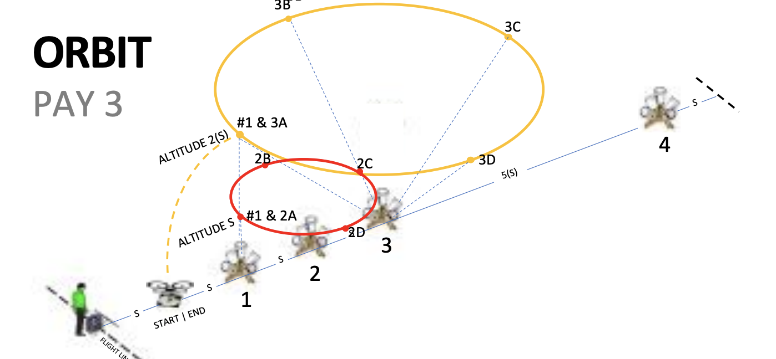
Orbit

