Slide 1
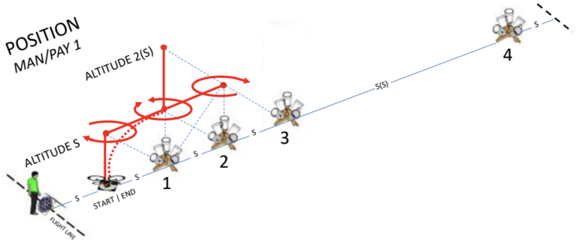


Position
NIST Open Test Range

Slide 2
Introduction
Successfully perform a series of maneuvers between designated hover positions along the lane centerline.
  Demonstrate basic flight maneuvers between designated hover positions, orientations, and altitudes along the lane centerline at altitudes S and 2(S). (S=Altitude and is also the distance between bucket stands. If bucket stands are spaced 10 feet apart then your maximum altitude should be 10 ft AGL)
  Climb, descend, yaw, pitch, and roll to simultaneously TAKE A PICTURE OF downward buckets to check position then forward buckets to check altitude.
  Complete 10 positions along the lane centerline with 18 alignments and 1 accurate landing (counts double) to score up to 100 points.

Slide 3
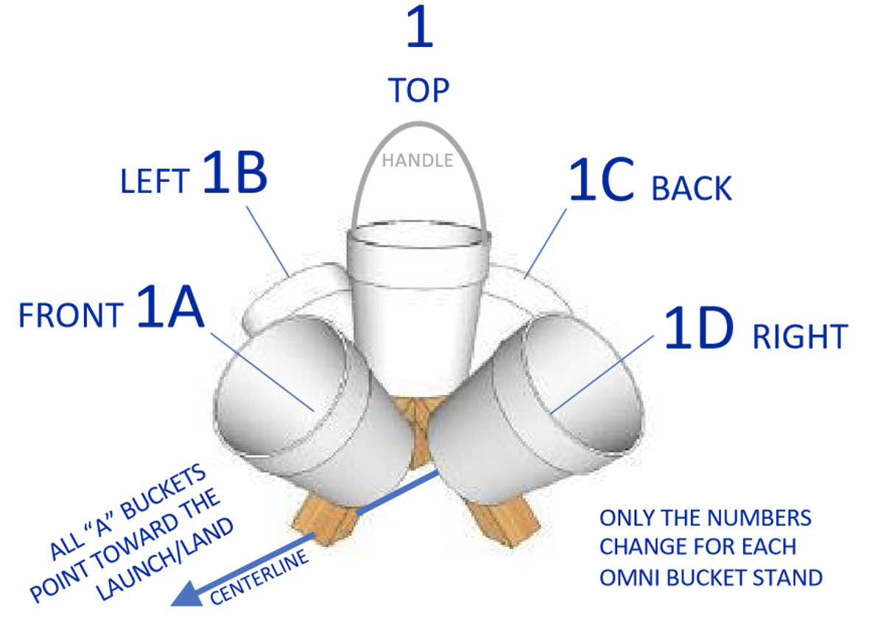
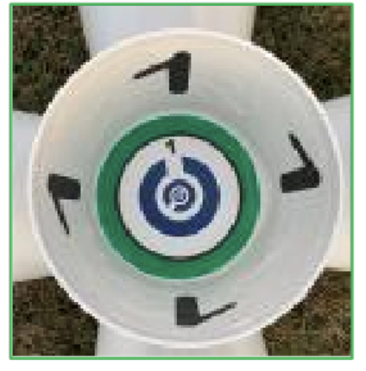
Setup

Slide 4
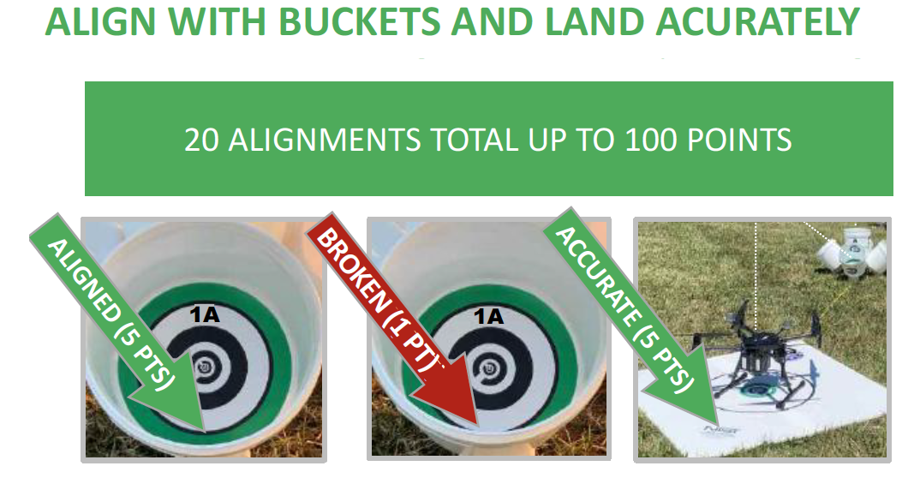
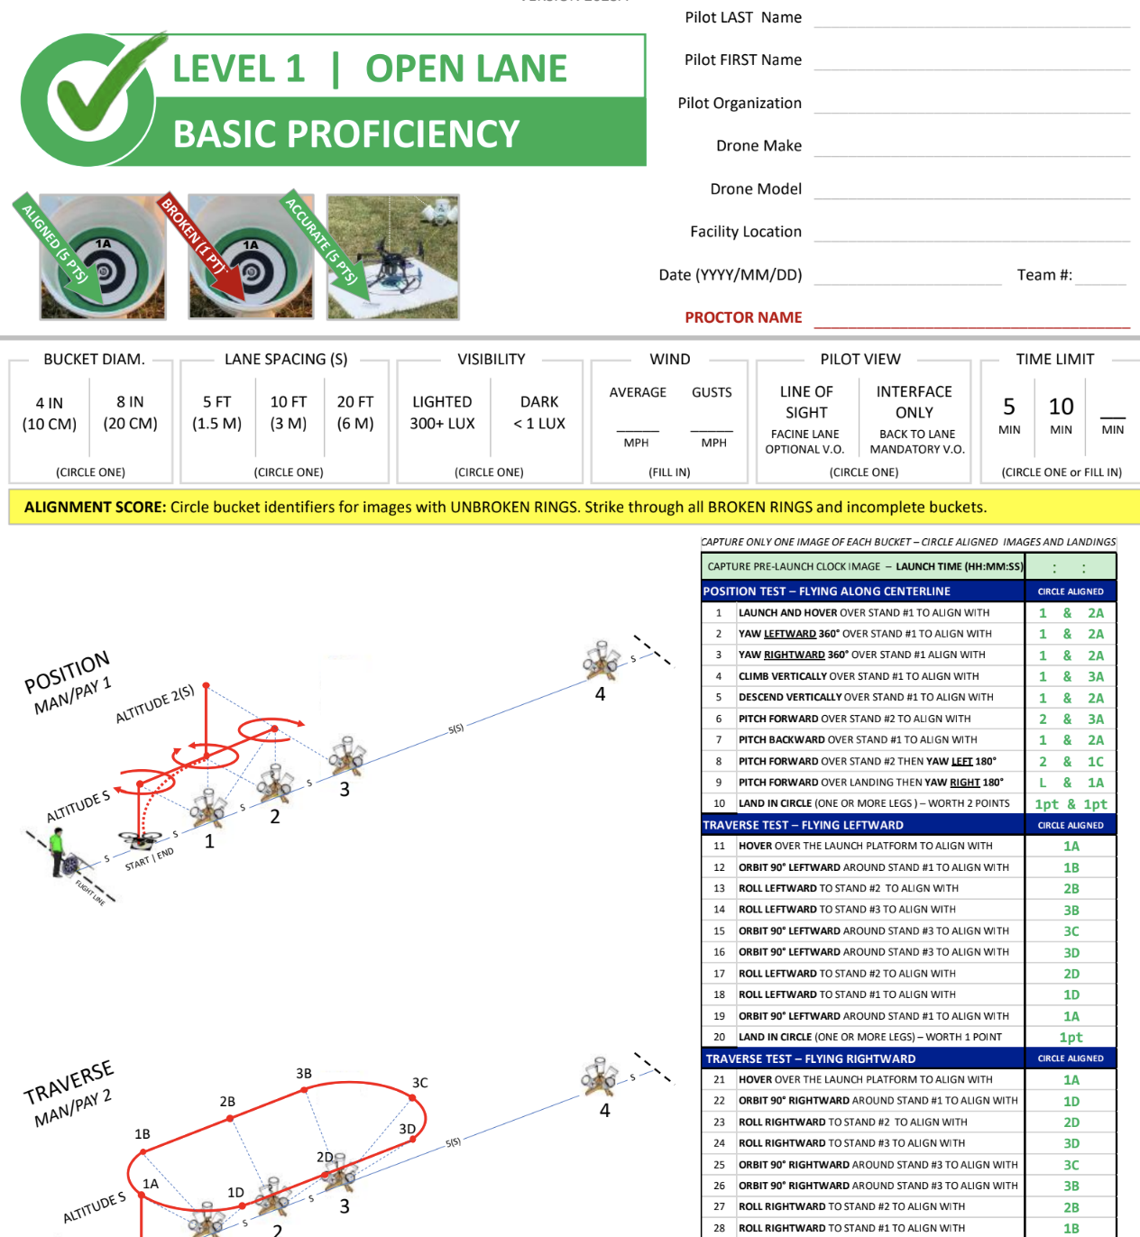
Scoring
Score captured images as:
  UNBROKEN RINGS (5 points)
  BROKEN RINGS (1 point)
  NO RINGS (0 points, strike through line)
Score accurate landings as:
  CENTERED (5 pts) with the aircraft center point inside the 60 cm (24 in) diameter circle.
  OFFSET (1 pts) with at least one propeller motor inside the circle.
https://drive.google.com/file/d/1pp-k9ea70r_pVBhWh-rdwTMgxdYju3Mf/view?usp=sharing

Slide 5
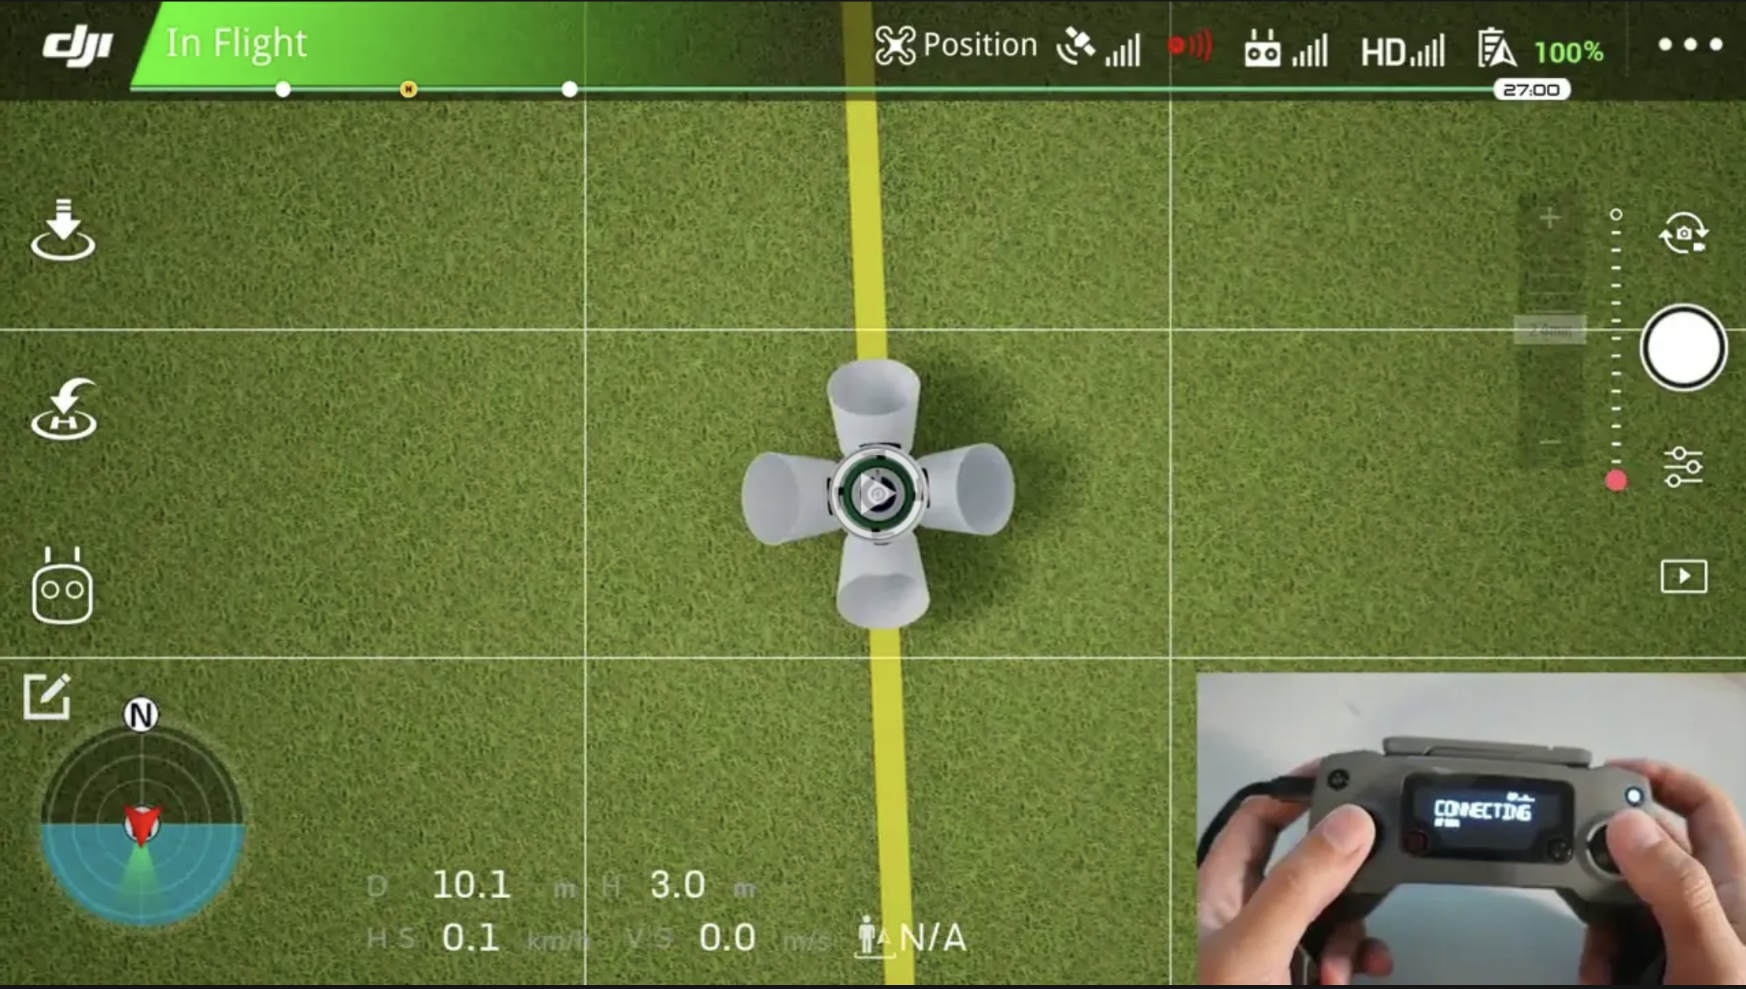
Position

Slide 6
Procedure
POSITION TEST – FLYING ALONG CENTERLINE
LAUNCH AND HOVER OVER STAND #1 TAKE A PICTURE OF BUCKET 1&BUCKET 2A
YAW LEFTWARD 360° OVER STAND #1 TAKE A PICTURE OF BUCKET 1&BUCKET 2A
YAW RIGHTWARD 360° OVER STAND #1 TAKE A PICTURE OF BUCKET 1&BUCKET 2A
CLIMB VERTICALLY (2XS) OVER STAND #1 TAKE A PICTURE OF BUCKET 1&BUCKET 3A
DESCEND VERTICALLY OVER STAND #1 TAKE A PICTURE OF BUCKET 1&BUCKET 2A
PITCH FORWARD OVER STAND #2 TAKE A PICTURE OF BUCKET 2&BUCKET 3A
PITCH BACKWARD OVER STAND #1 TAKE A PICTURE OF BUCKET 1&BUCKET 2A
PITCH FORWARD OVER STAND #2 THEN YAW LEFT 180° TAKE A PICTURE OF BUCKET 2&BUCKET 1C
PITCH FORWARD OVER LANDING THEN YAW RIGHT 180° TAKE A PICTURE OF LANDING PAD&BUCKET 1A
LAND IN CIRCLE (ONE OR MORE LEGS ) – WORTH 2 POINTS

Slide 7
Position

