Slide 1
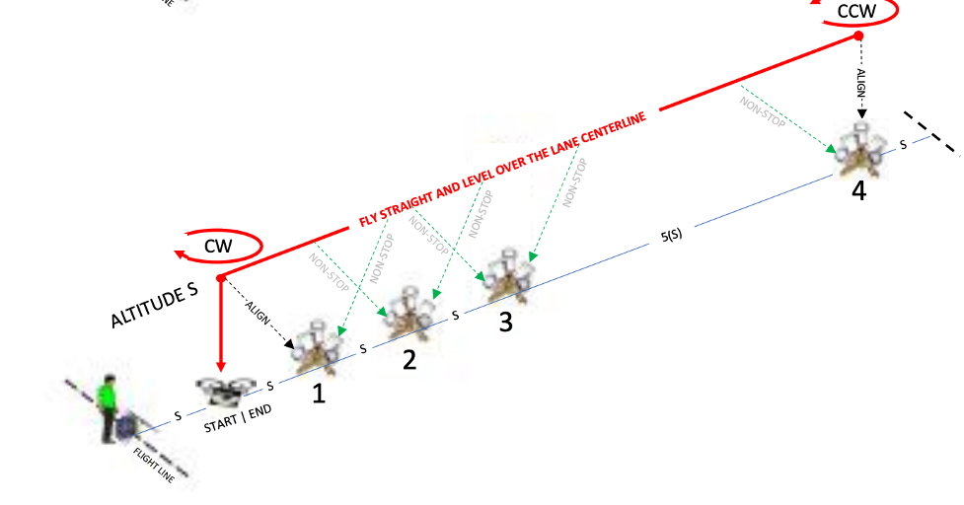


Recon
NIST Open Test Range

Slide 2
Introduction
Establish stable hovers and perform reconnaissance tasks over designated objects.
  Fly straight and level over the centerline to establish a stable hover over an object down range to perform reconnaissance tasks.
  Maintain altitude S to TAKE A PICTURE OF buckets and the landing at each end of the lane. Reconnaissance tasks are performed every 8(S) over a total distance of 80(S).
  Complete 5 laps (or 10 lane lengths) with 20 alignments to score up to 100 points.

Slide 3
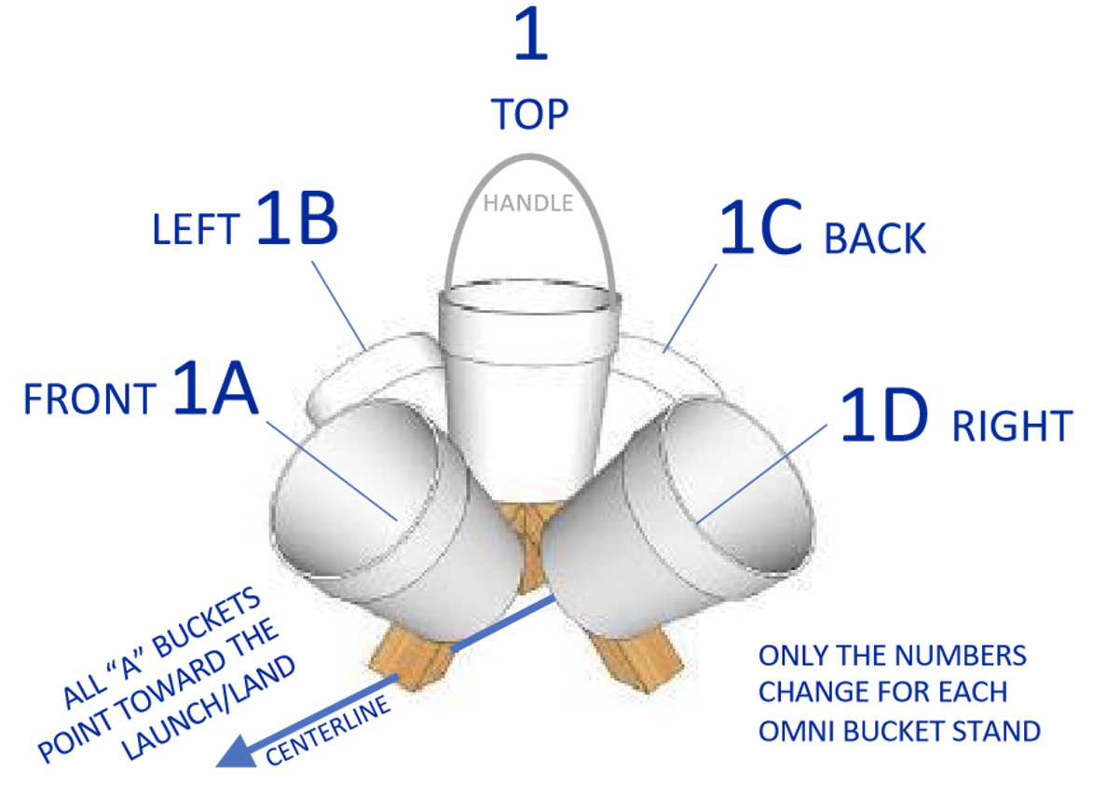
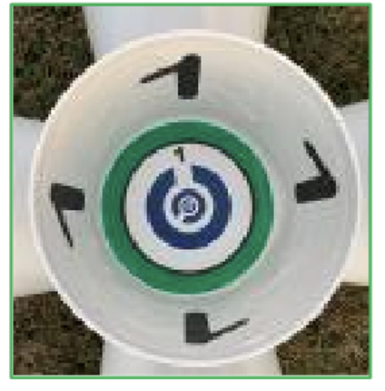
Setup

Slide 4
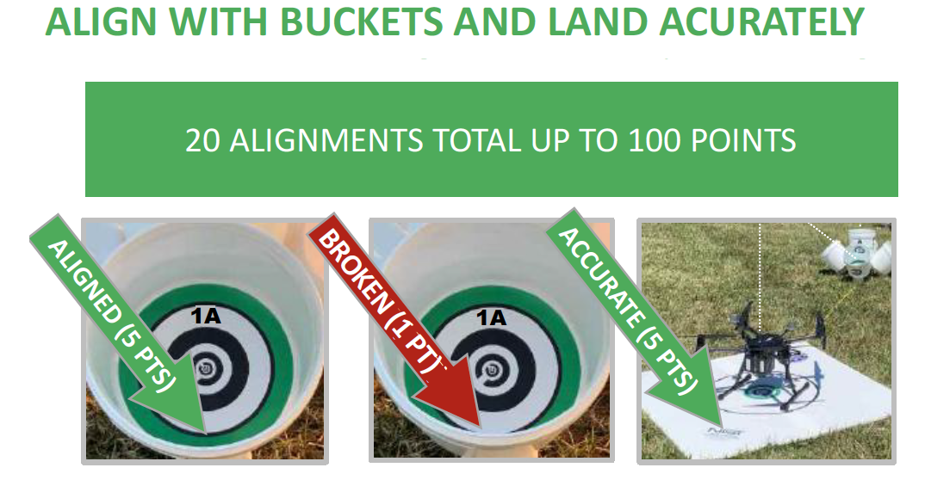
Scoring
Score captured images as:
  UNBROKEN RINGS (5 points)
  BROKEN RINGS (1 point)
  NO RINGS (0 points, strike through line)
Score accurate landings as:
  CENTERED (5 pts) with the aircraft center point inside the 60 cm (24 in) diameter circle.
  OFFSET (1 pts) with at least one propeller motor inside the circle.

Slide 5
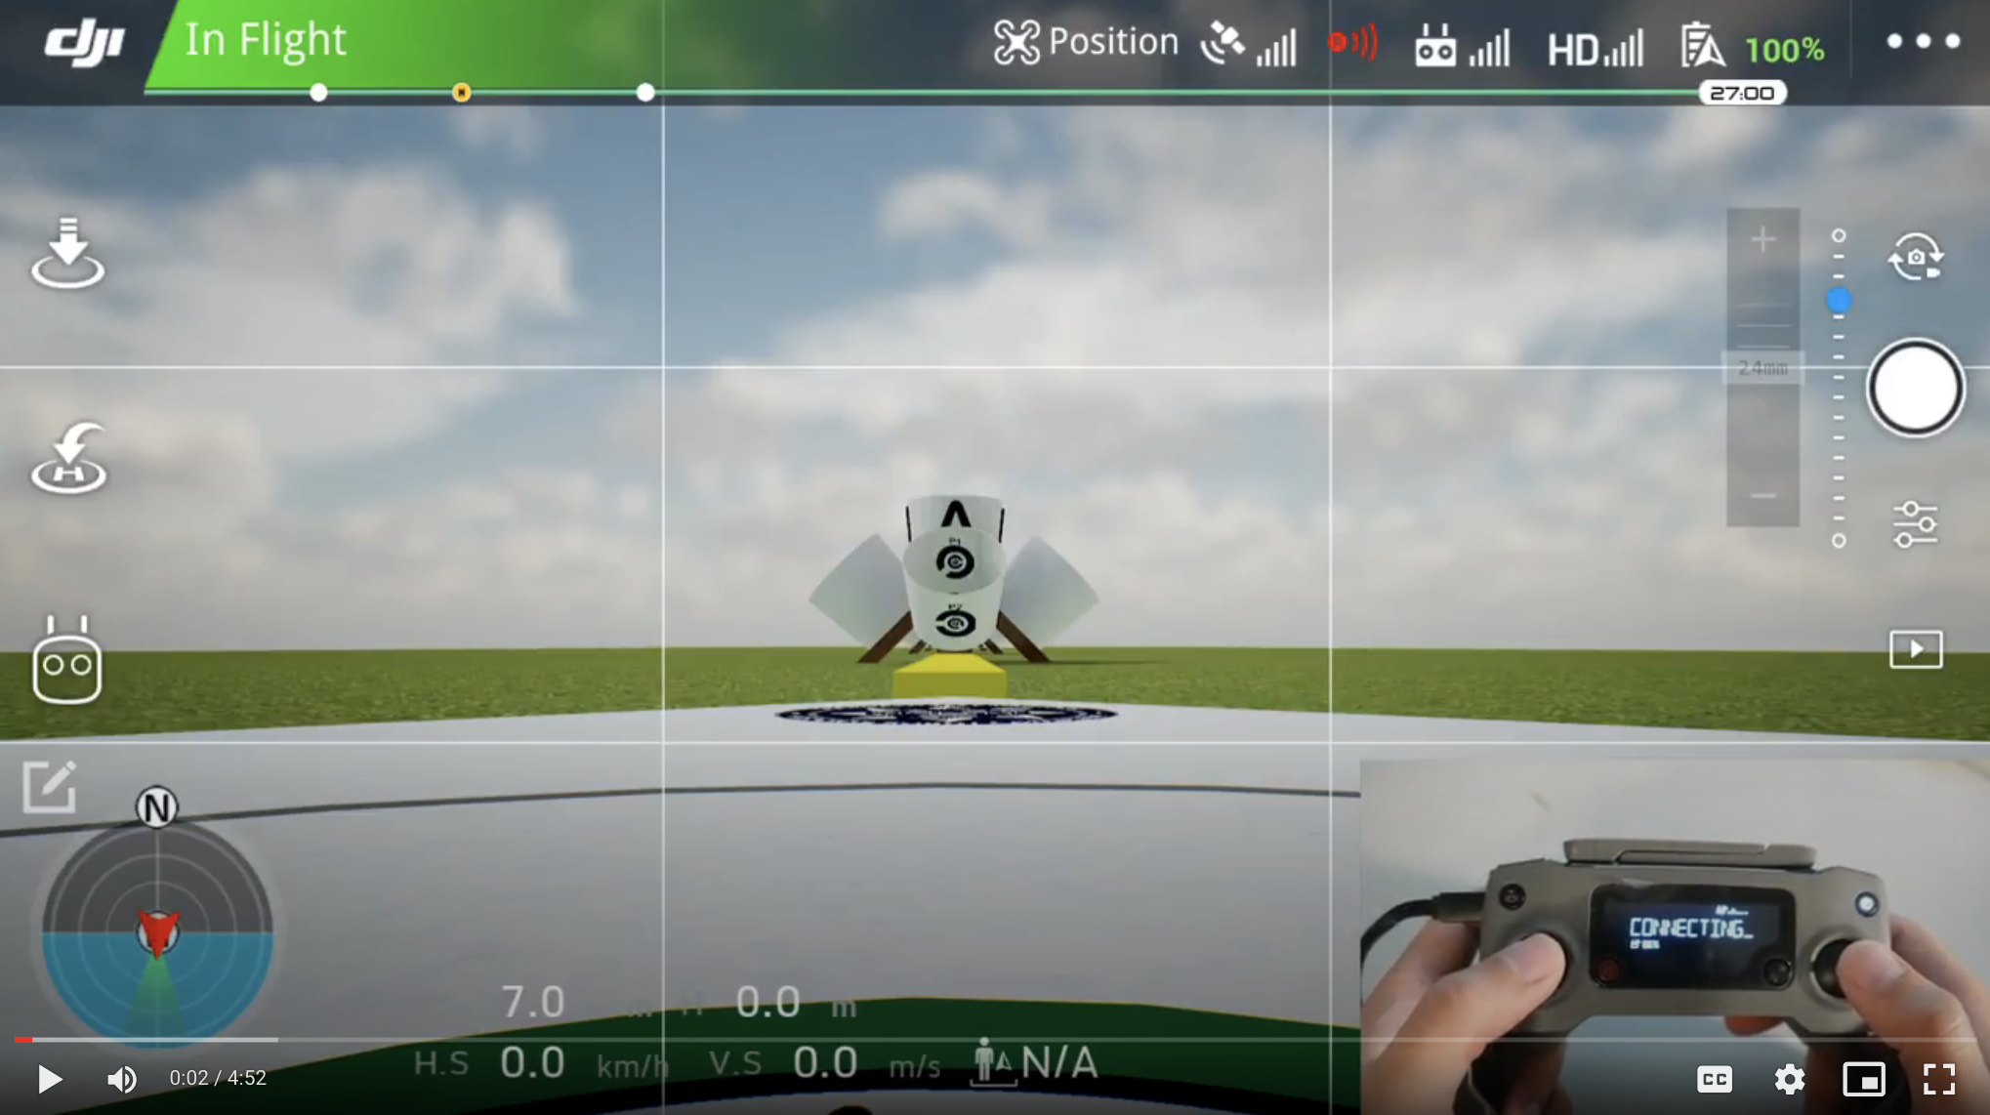
Inspect

Slide 6
Procedure
FLY AT ALTITUDE S TO STAND #4 TAKE A PICTURE OF BUCKET 4
YAW LEFT 180° TAKE A PICTURE OF BUCKET 4
FLY TO THE LAUNCH AND YAW RIGHT 180° TAKE A PICTURE OF LAUNCH PAD
HOVER IN PLACE CHECK ALTITUDE S TAKE A PICTURE OF BUCKET 1A
FLY AT ALTITUDE S TO STAND #4 TAKE A PICTURE OF BUCKET 4
YAW LEFT 180° TAKE A PICTURE OF BUCKET 4
FLY TO THE LAUNCH AND YAW RIGHT 180°TAKE A PICTURE OF LAUNCH PAD
HOVER IN PLACE CHECK ALTITUDE S TAKE A PICTURE OF BUCKET 1A
FLY AT ALTITUDE S TO STAND #4 TAKE A PICTURE OF BUCKET 4
YAW LEFT 180° TAKE A PICTURE OF BUCKET 4
FLY TO THE LAUNCH AND YAW RIGHT 180° TAKE A PICTURE OF LAUNCH PAD
HOVER IN PLACE CHECK ALTITUDE S TAKE A PICTURE OF BUCKET 1A
FLY AT ALTITUDE S TO STAND #4 TAKE A PICTURE OF BUCKET 4
YAW LEFT 180°TAKE A PICTURE OF BUCKET 4
FLY TO THE LAUNCH AND YAW RIGHT 180° TAKE A PICTURE OF LAUNCH PAD
HOVER IN PLACE CHECK ALTITUDE S TAKE A PICTURE OF BUCKET 1A
FLY AT ALTITUDE S TO STAND #4 TAKE A PICTURE OF BUCKET 4
YAW LEFT 180° TAKE A PICTURE OF BUCKET 4
FLY TO THE LAUNCH AND YAW RIGHT 180° TAKE A PICTURE OF LAUNCH PAD
HOVER IN PLACE CHECK ALTITUDE S TAKE A PICTURE OF BUCKET 1A

Slide 7
Recon

