Slide 1
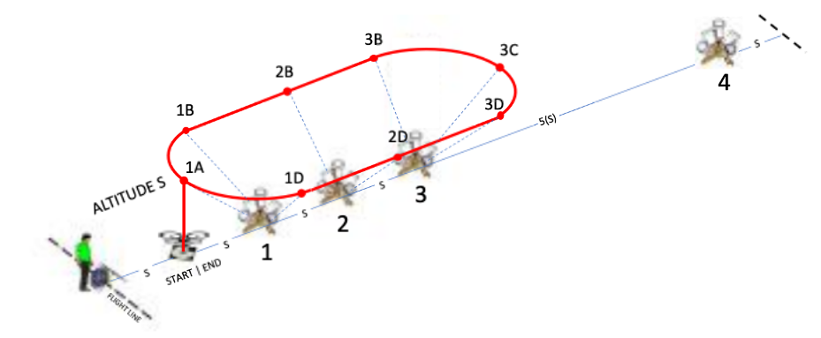


Traverse
NIST Open Test Range

Slide 2
Introduction
Successfully perform a series of maneuvers between designated hover positions along the lane centerline.
Complete laps around omni bucket stands, aligning with designated buckets.
  Fly sideways parallel to objects while looking forward to identify features as if along a road, truck, bus, building, fence, tree line, etc.
  Maintain altitude S flying leftward and rightward around the first three bucket stands to TAKE A PICTURE OF all the designated buckets.
  Complete 1 lap leftward then 1 lap rightward with 18 alignments and 2 accurate landings to score up to 100 points.

Slide 3
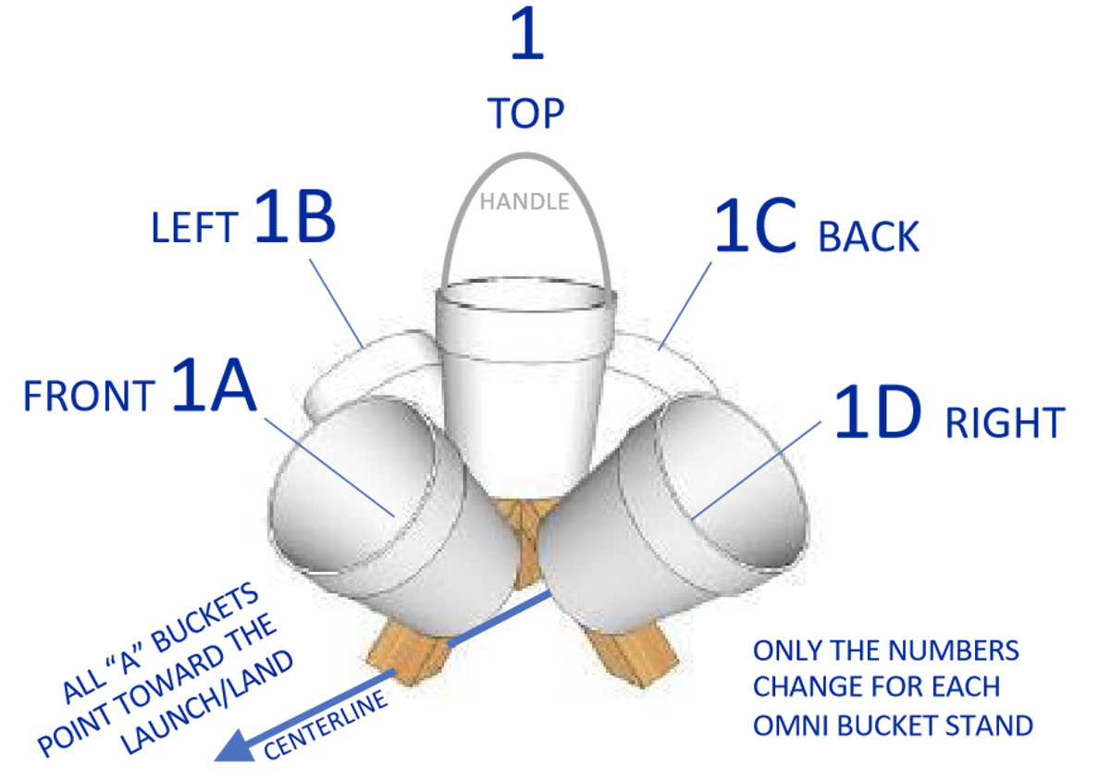
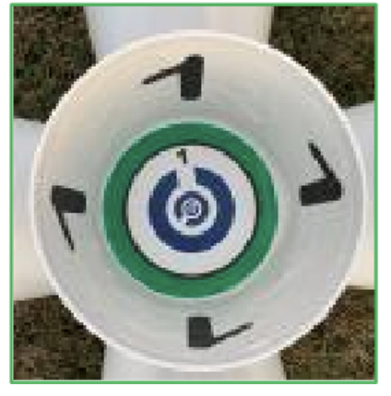
Setup

Slide 4
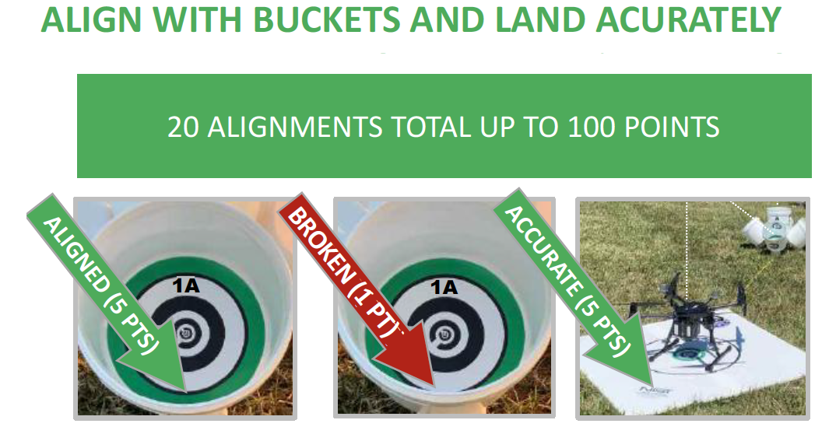
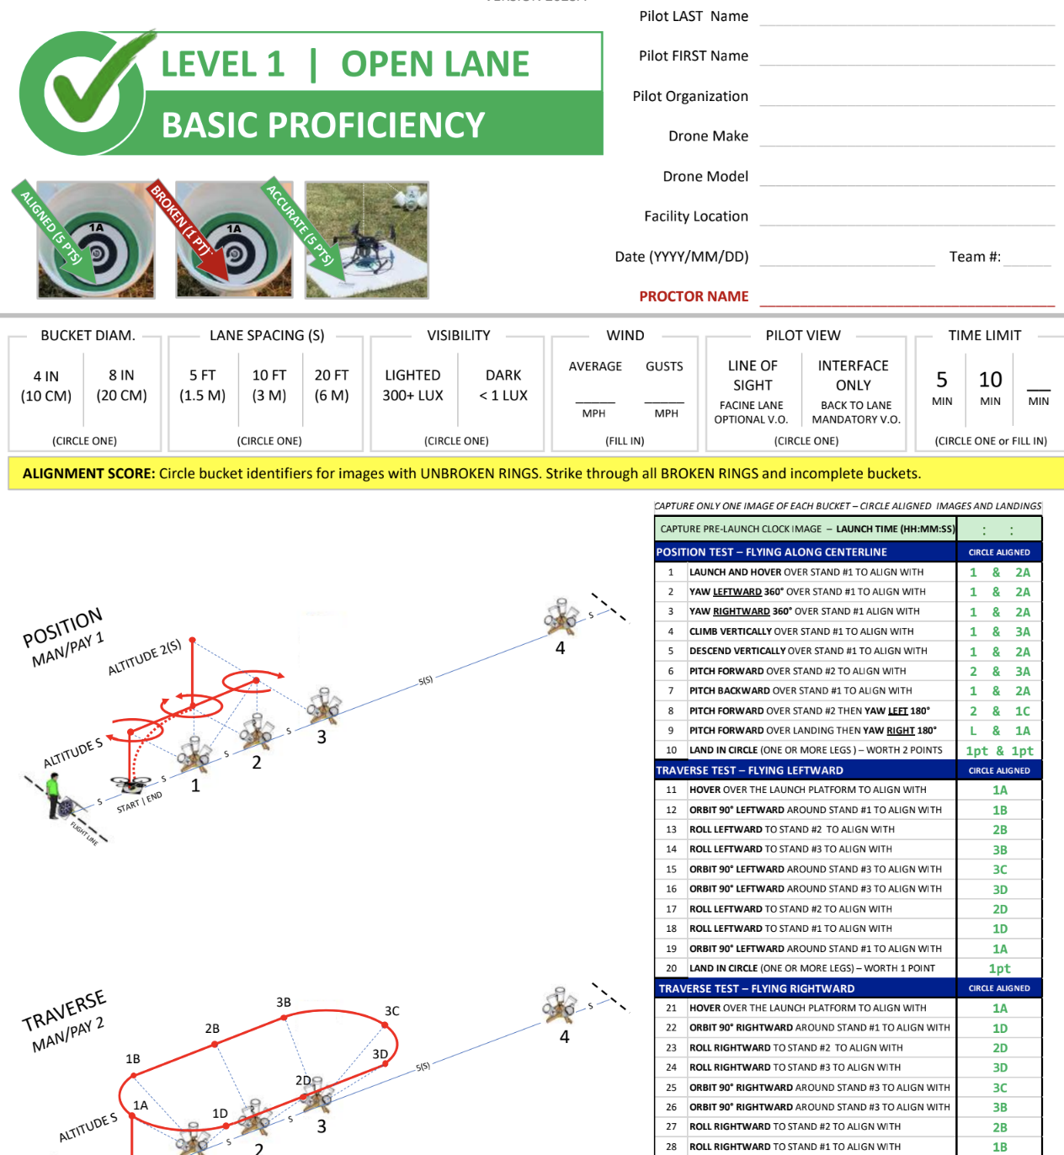
Scoring
Score captured images as:
  UNBROKEN RINGS (5 points)
  BROKEN RINGS (1 point)
  NO RINGS (0 points, strike through line)
Score accurate landings as:
  CENTERED (5 pts) with the aircraft center point inside the 60 cm (24 in) diameter circle.
  OFFSET (1 pts) with at least one propeller motor inside the circle.
https://drive.google.com/file/d/1pp-k9ea70r_pVBhWh-rdwTMgxdYju3Mf/view?usp=sharing

Slide 5
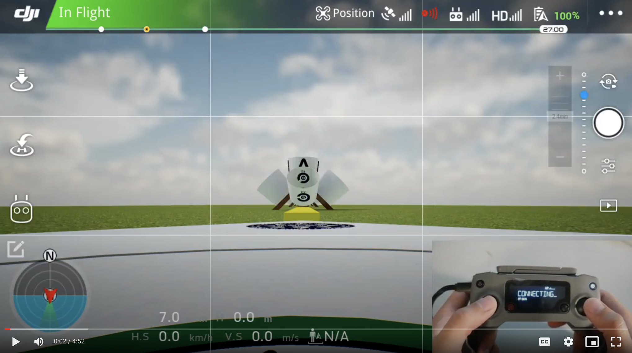
Traverse

Slide 6
Procedure
TRAVERSE TEST – FLYING LEFTWARD
HOVER OVER THE LAUNCH PLATFORM TAKE A PICTURE OF BUCKET 1A
ORBIT 90° LEFTWARD AROUND STAND #1 TAKE A PICTURE OF BUCKET 1B
ROLL LEFTWARD TO STAND #2 TAKE A PICTURE OF BUCKET 2B
ROLL LEFTWARD TO STAND #3 TAKE A PICTURE OF BUCKET 3B
ORBIT 90° LEFTWARD AROUND STAND #3 TAKE A PICTURE OF BUCKET 3C
ORBIT 90° LEFTWARD AROUND STAND #3 TAKE A PICTURE OF BUCKET 3D
ROLL LEFTWARD TO STAND #2 TAKE A PICTURE OF BUCKET 2D
ROLL LEFTWARD TO STAND #1 TAKE A PICTURE OF BUCKET 1D
ORBIT 90° LEFTWARD AROUND STAND #1 TAKE A PICTURE OF BUCKET 1A
LAND IN CIRCLE (ONE OR MORE LEGS) – WORTH 1 POINT
TRAVERSE TEST – FLYING RIGHTWARD
HOVER OVER THE LAUNCH PLATFORM TAKE A PICTURE OF BUCKET 1A
ORBIT 90° RIGHTWARD AROUND STAND #1 TAKE A PICTURE OF BUCKET 1D
ROLL RIGHTWARD TO STAND #2 TAKE A PICTURE OF BUCKET 2D
ROLL RIGHTWARD TO STAND #3 TAKE A PICTURE OF BUCKET 3D
ORBIT 90° RIGHTWARD AROUND STAND #3 TAKE A PICTURE OF BUCKET 3C
ORBIT 90° RIGHTWARD AROUND STAND #3 TAKE A PICTURE OF BUCKET 3B
ROLL RIGHTWARD TO STAND #2 TO ALIGN TAKE A PICTURE OF BUCKET 2B
ROLL RIGHTWARD TO STAND #1 TO ALIGN TAKE A PICTURE OF BUCKET 1B
ORBIT 90° RIGHTWARD AROUND STAND #1 TAKE A PICTURE OF BUCKET 1A
LAND IN CIRCLE (ONE OR MORE LEGS ) – WORTH 1 POINT

Slide 7
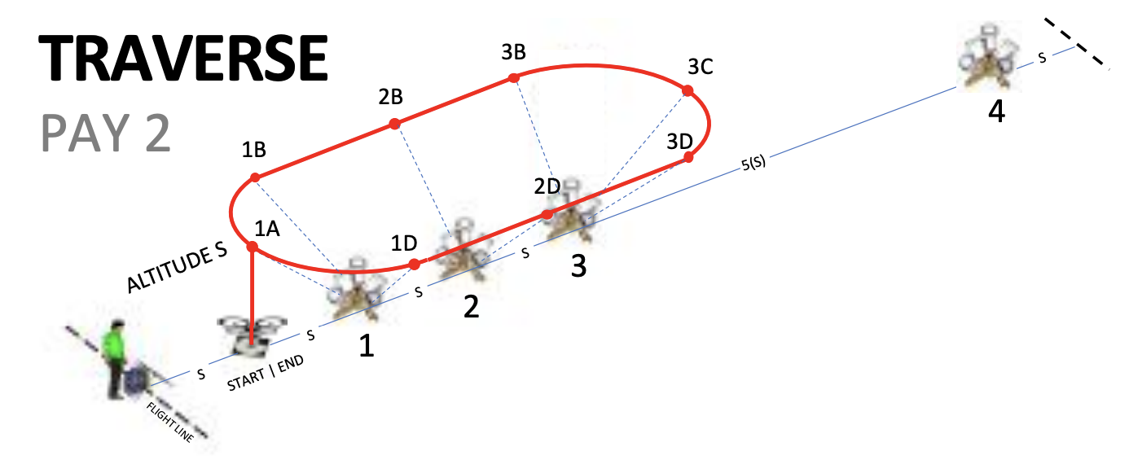
Traverse

